Slide 1




DABANGG: A Case for Noise Resilient Flush-Based Cache Attacks
WOOT 2022
Anish Saxena
Biswabandan Panda
Georgia Institute of Technology
Indian Institute of Technology Kanpur
Indian Institute of Technology Bombay

Slide 2
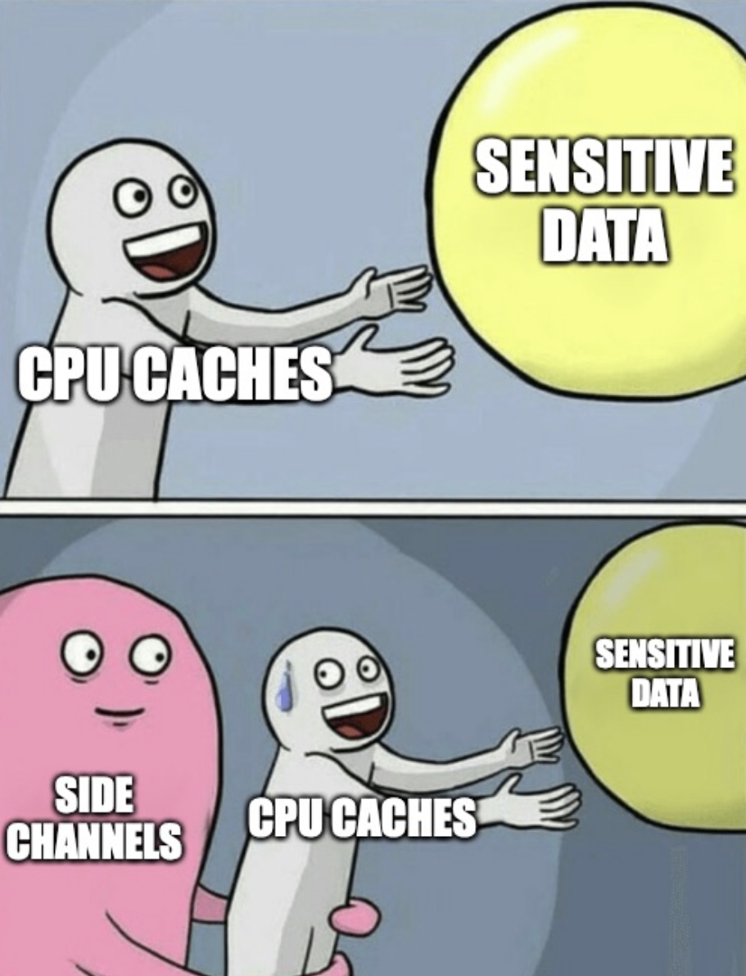


Cache Timing-based Attacks
Calibrate
Attack
Leak Information
Brittle Behavior
Low Accuracy
Reduced Stealth

Slide 3
Outline for Today
What are Flush-based Cache Attacks?
How well do they perform in the wild?
Can we make them resilient to system noise?
What is the impact of DABANGG refinements?

Slide 4
Outline for Today
What are Flush-based Cache Attacks?
How well do they perform in the wild?
Can we make them resilient to system noise?
What is the impact of DABANGG refinements?

Slide 5
Primer: Flush-based Cache Attacks
Victim Process
Last Level Cache (LLC)
Spy Process
Shared Address A
Shared Address A
Shared Address A
load A
load A
clflush A
clflush A
LLC reload Hit
⇒ Victim accessed A!
LLC clflush Hit
⇒ Victim accessed A!
t = 0
Phase 1: Flush
Phase 2: Wait
Phase 3: Reload (Flush + Reload)
or
Phase 3: Flush (Flush + Flush)

Slide 6
Primer: Flush-based Cache Attacks
Victim Process
Last Level Cache (LLC)
Spy Process
Shared Address A
Shared Address A
Shared Address A
load A
load A
clflush A
clflush A
How do we differentiate a cache hit from a miss?
LLC reload Hit
⇒ Victim accessed A!
LLC clflush Hit
⇒ Victim accessed A!
Phase 3: Reload (Flush + Reload)
Calibration!
or
Phase 3: Flush (Flush + Flush)

Slide 7







Primer: Flush-based Cache Attacks
Calibrate
Attack
Profit
Cache miss
Measure Latency
Threshold
Leak crypto keys
Latency
How does it play out in practice?
Cache hit?
Covert channels
Cache hit
Iterations
⇒ Victim accessed address!
Log Keystrokes
And much more

Slide 8
Outline for Today
What are Flush-based Cache Attacks?
How well do they perform in the wild?
Can we make them resilient to system noise?
What is the impact of DABANGG refinements?

Slide 9
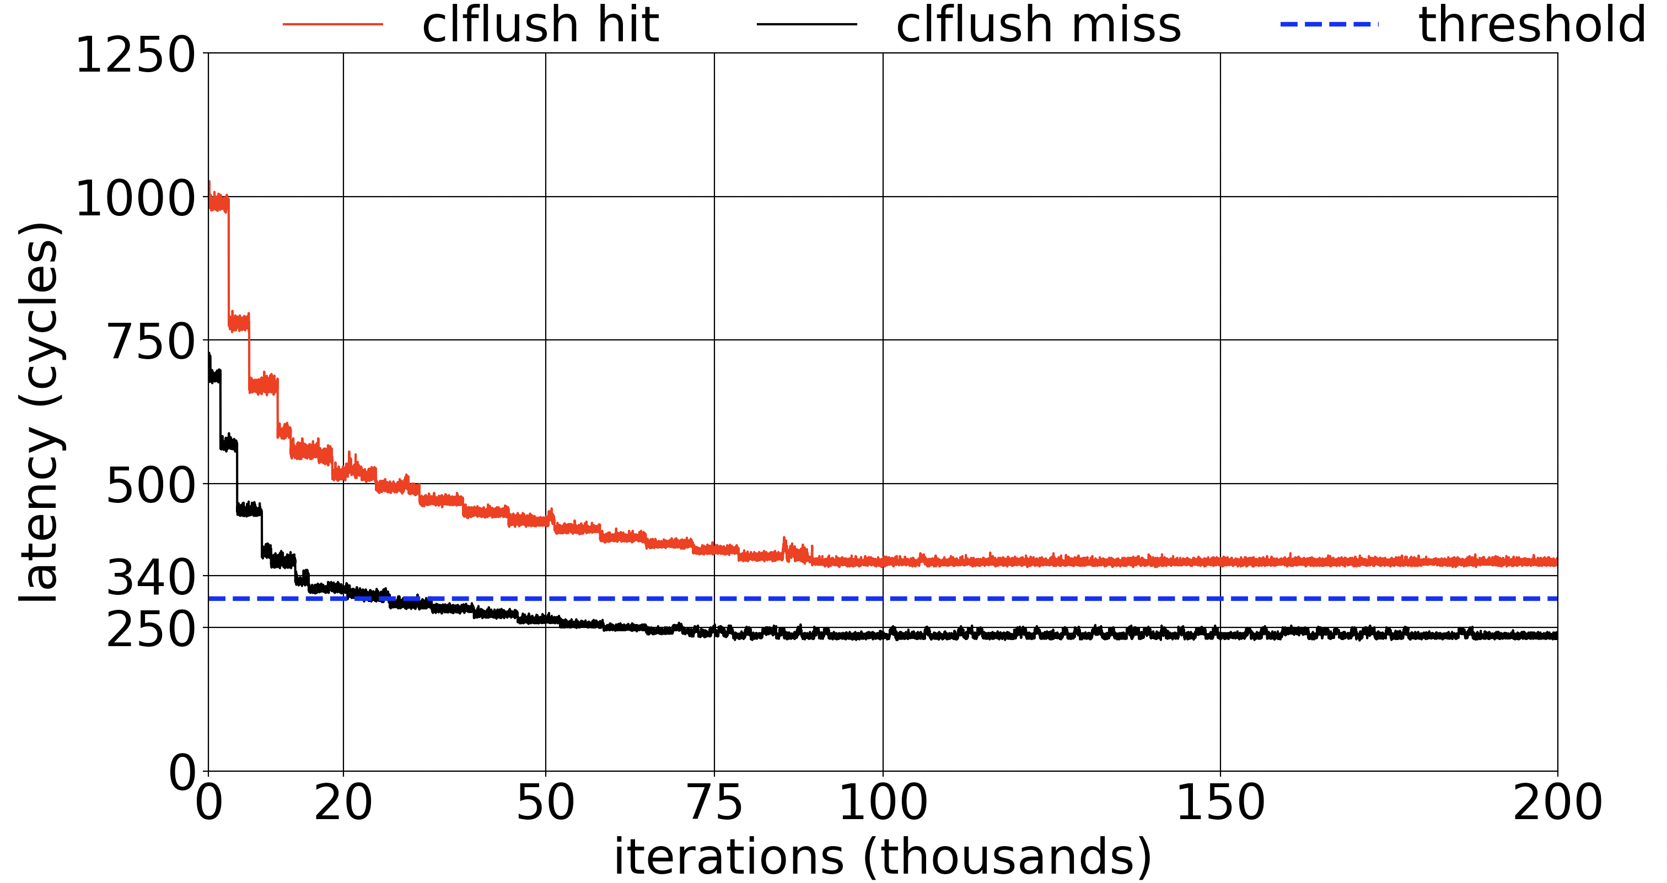
Coming back to reality
Intel Xeon W-2145 Skylake
8 cores/ 16 threads
Frequency 1.2 – 4.5 GHz
Expectations
What’s the root cause? How can we fix this?
Reality

Slide 10


Frequency Scaling and Core Placement
Processor frequency is variable
OS can change core placement
Core 0
Core 1
Core 2
Core 3
Core 0
Core 1
Core 2
Core 3
1GHz
4GHz
1GHz
4GHz
1GHz
4GHz
1GHz
4GHz
Higher latency
Lower latency

Slide 11
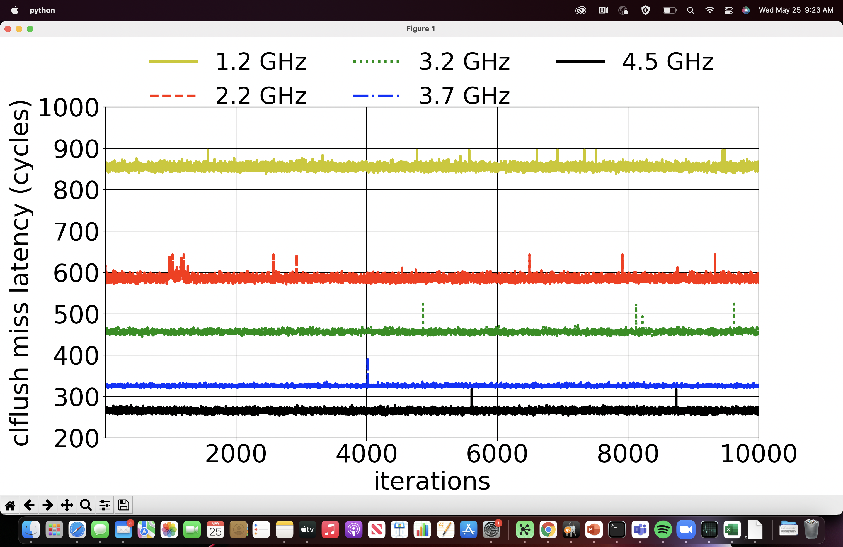
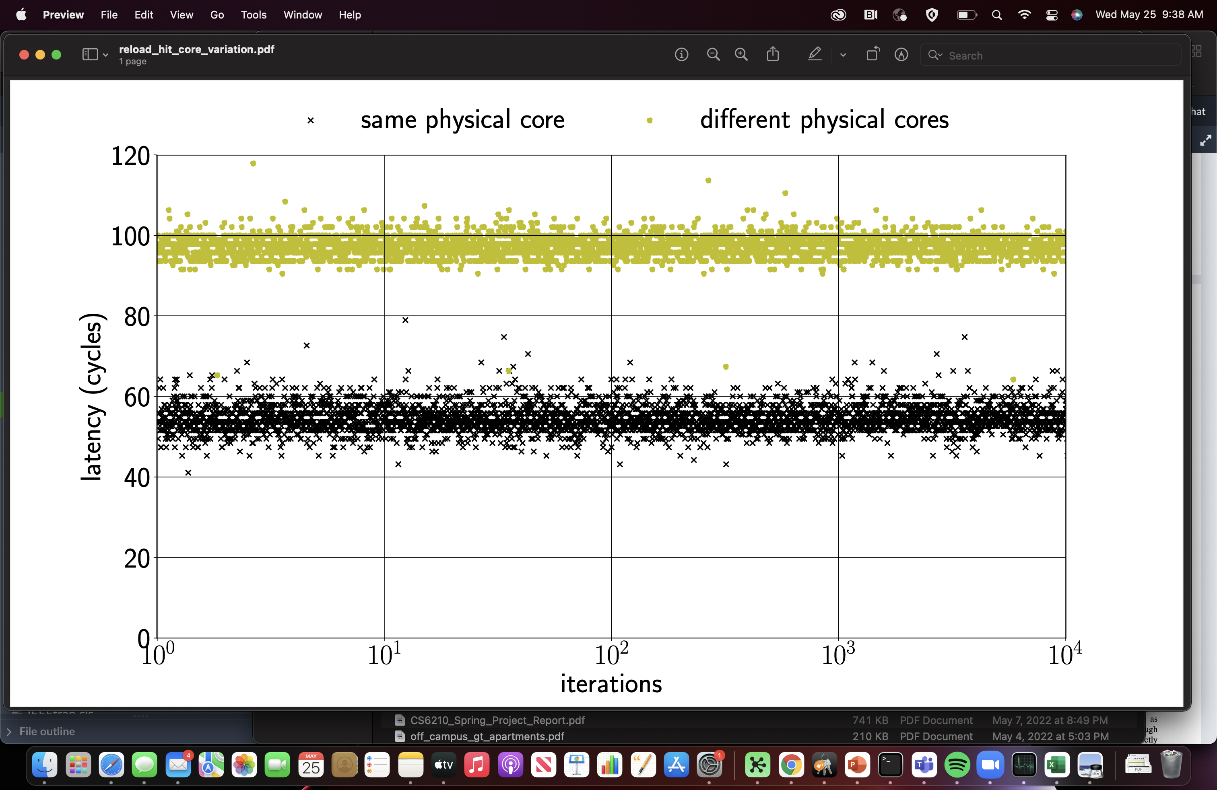
Frequency Scaling and Core Placement
reload hit
Impact of DVFS
Impact of OS Scheduling

Slide 12
Outline for Today
What are Flush-based Cache Attacks?
How well do they perform in the wild?
Can we make them resilient to system noise?
What is the impact of DABANGG refinements?

Slide 13
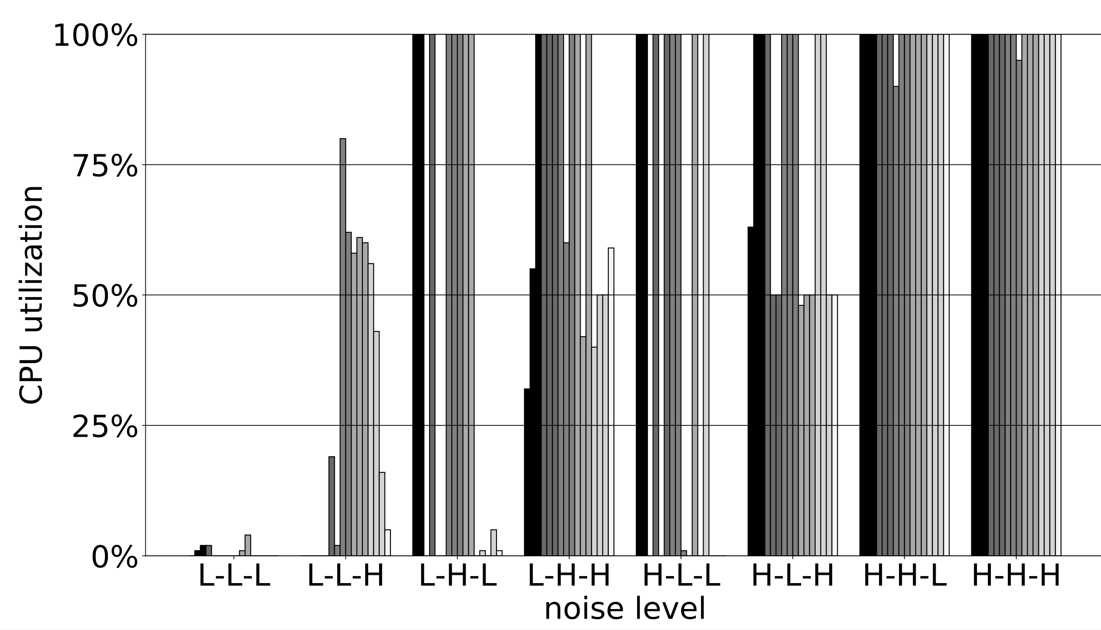
Let’s parameterize system noise
Compute
Memory
Example: crypto functions
Effect: frequency ↑
Example: graph traversal
Effect: frequency ↑
C-M-I
IO
L-L-L
L-L-H
.
.
.
H-H-H
Example: DB query
Effect: frequency
~

Slide 14

Existing Calibration Techniques
50
40
Threshold?
Latency
30
20
10
Iterations
Reload hit
Reload miss

Slide 15
DABANGG Calibration
Miss Mode #4
Hit Modes | 10 | 20 | 30 | 40 | 40
Miss Modes | 25 |  | 35 | 45 | 55
50
Miss Mode #3
Hit Mode #4
40
Miss Mode #2
Hit Mode #3
Latency
30
Miss Mode #1
Hit Mode #2
20
Hit Mode #1
10
Iterations
Reload hit
Reload miss

Slide 16
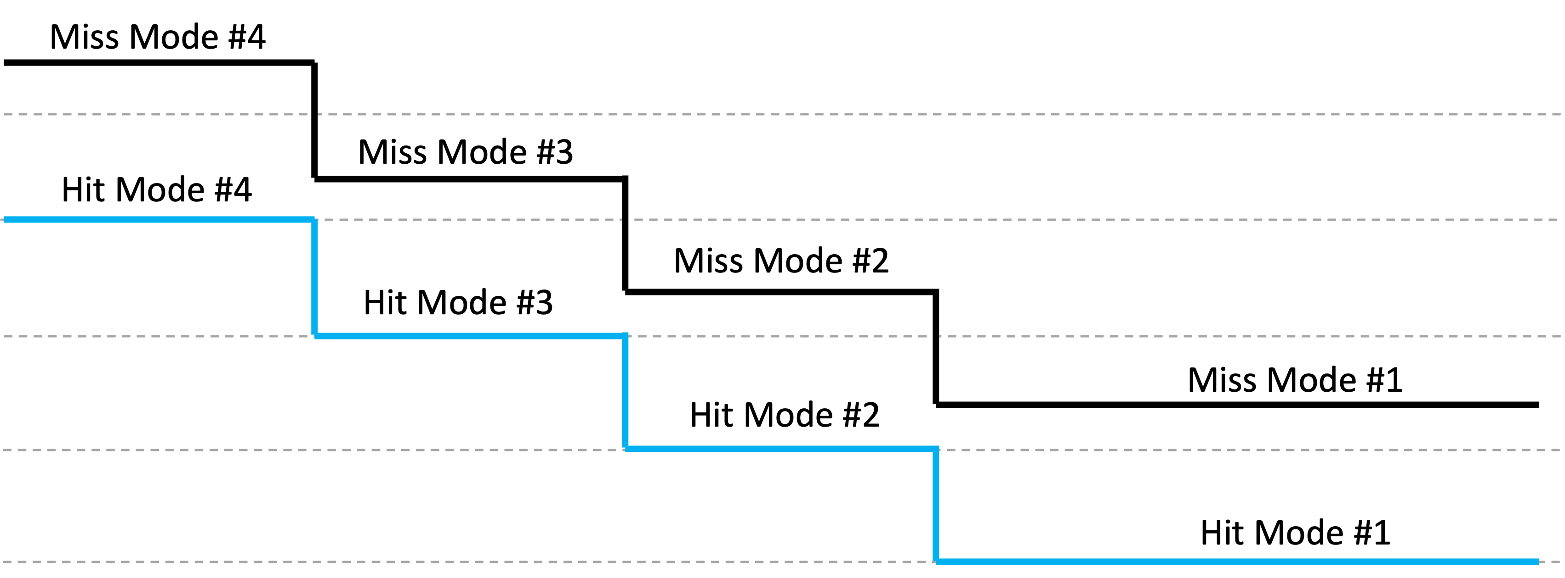
DABANGG Calibration
Hit Modes | 10 | 20 | 30 | 40 | 40
Miss Modes | 25 |  | 35 | 45 | 55
50
40
Lower Thresholds
5
27.5
37.5
Upper Thresholds
22.5
32.5
42.5
Latency
30
20
Tuple 1
Tuple 2
Tuple 3
10
Iterations
Reload hit
Reload miss

Slide 17

DABANGG Calibration

Slide 18


DABANGG+FLUSH+RELOAD Attack Loop
Choose correct threshold tuple
Dynamically assign threshold
Periodically Verify
Flush
Wait using compute-intensive loop
Dynamically set wait period
Reload
Check for false-positives
Check for frequent burst-mode accesses
Core 0
Core 1
Core 2
Core 3
sched_yield()
. . . Miss, Hit, Hit, Miss, Hit, Hit, Miss . . .
. . . Miss, Miss, Miss, Hit, Miss, Miss . . .

Slide 19
DABANGG+FLUSH+RELOAD Attack Loop
Choose correct threshold tuple
Dynamically assign threshold
Periodically Verify
Flush
Wait using compute-intensive loop
Dynamically set wait period
Reload
Check for false-positives
Check for frequent burst-mode accesses
Periodic Verification
Core 0
Core 1
Core 2
Core 3
Fine-Grained Waiting
sched_yield()
. . . Miss, Hit, Hit, Miss, Hit, Hit, Miss . . .
Custom Access Patterns
. . . Miss, Miss, Miss, Hit, Miss, Miss . . .

Slide 20
Outline for Today
What are Flush-based Cache Attacks?
How well do they perform in the wild?
Can we make them resilient to system noise?
What is the impact of DABANGG refinements?

Slide 21
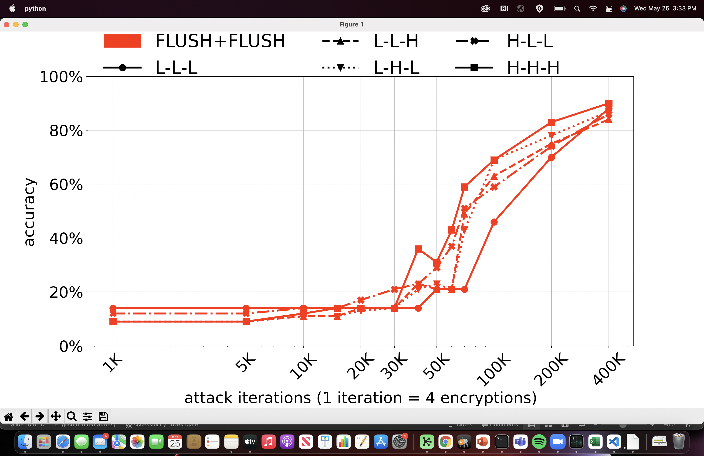
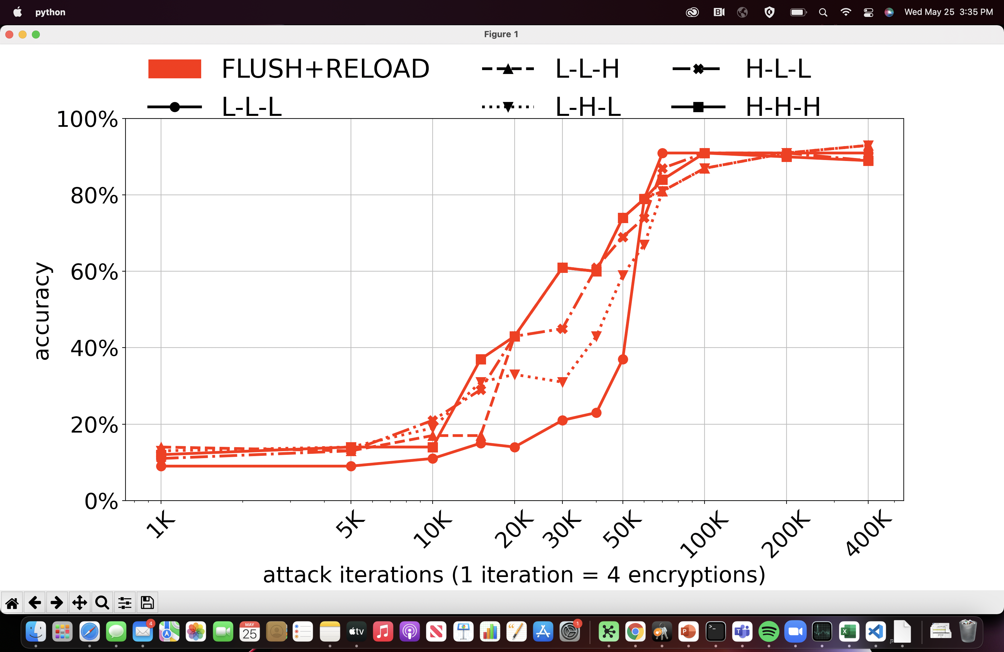
AES T-Table Private Key Extraction

Slide 22
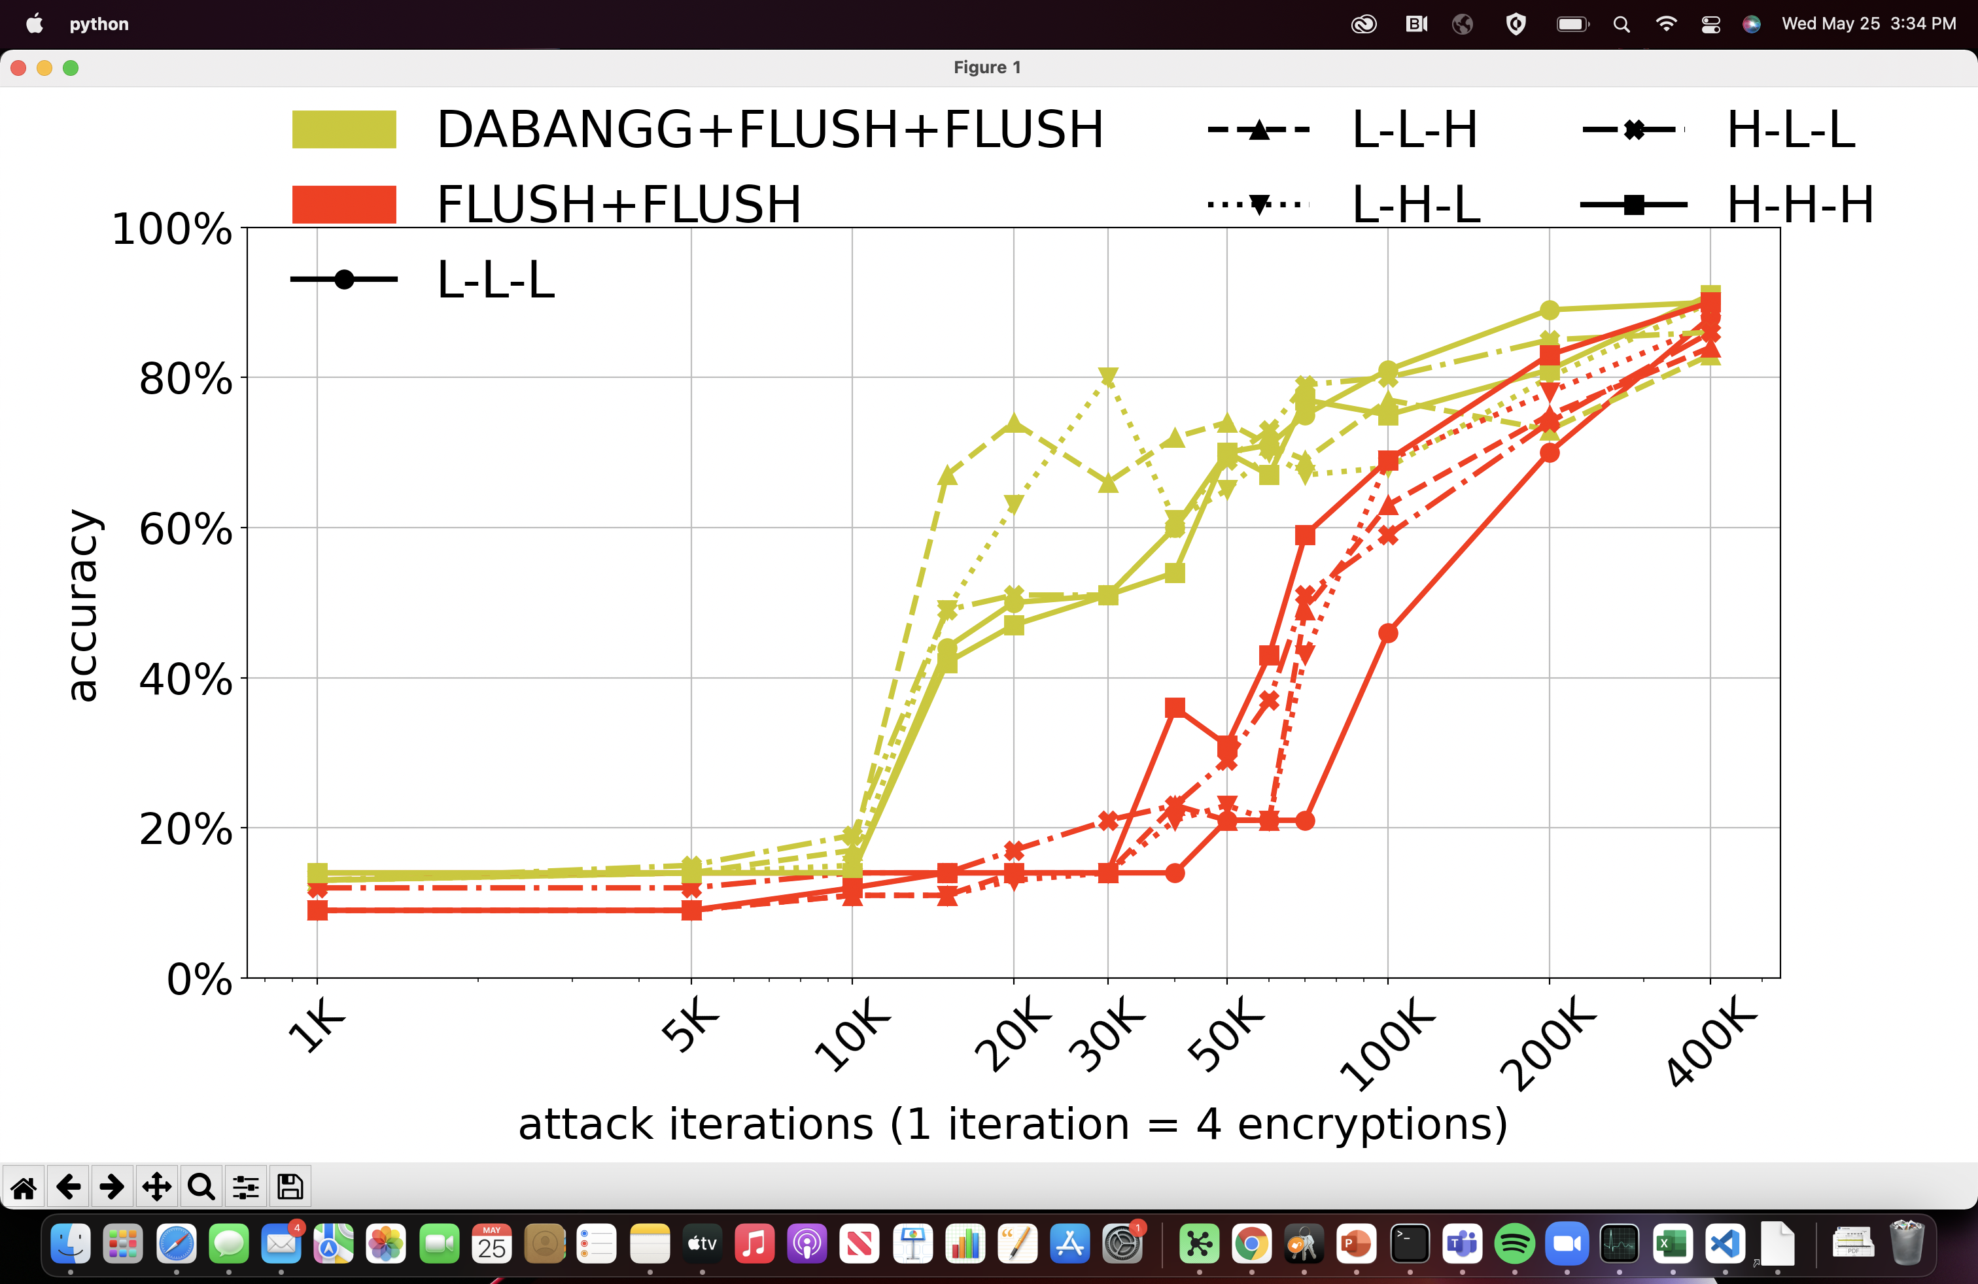
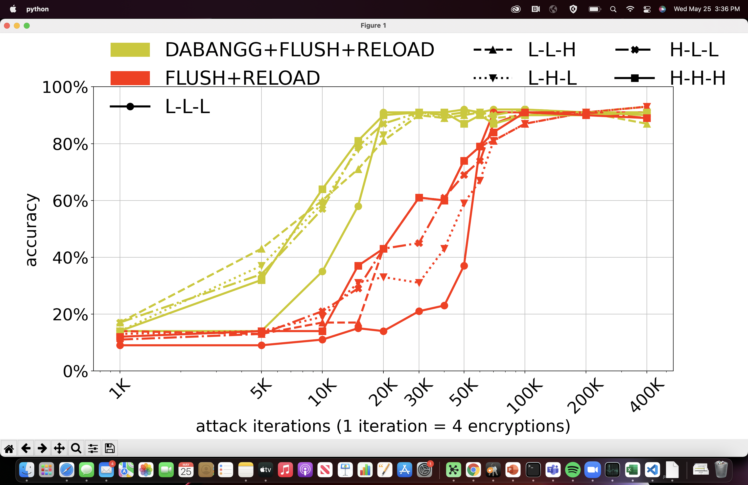
DABANGG-enabled AES Private Key Extraction

Slide 23
DABANGG-enabled AES Private Key Extraction
More experiments in the paper!

Slide 24
Future Directions
Frequency variation analysis is applicable to:
Eviction-based attacks
Prefetch-based attacks
Any instruction timing-based attack
Hardening detectors against system noise
Integrating DABANGG into existing tools and frameworks

Slide 25




DABANGG: Noise-Resilient Flush-based Attacks
Get the code, use it, improve it!
https://github.com/DABANGG-Attack/Source-Code
Responsible Disclosure
Intel coordinated with us in 2020 and allowed us to proceed without an embargo
Source Code
1
2
3
In the News!
and more
Anish Saxena
anish.Saxena@cc.gatech.edu
Georgia Institute of Technology
[1] https://thehackernews.com/2020/05/noise-resilient-flush-attack.html
[2] https://isc.sans.edu/podcastdetail.html?id=7018
[3] https://www.securityweek.com/new-technique-improves-effectiveness-timing-channel-attacks

